Slide 1

Covid-19 Risk Assessment
This template is advisory to assist managers in protecting your employees whilst continuing to operate as an organisation. Specific health issues should be referred to Occupational Health. Managers should apply the advice as part of the overall decision making and risk assessment – 17.03.2020
Risk Assessment
Risk Factor | Advice | Comment
Does the employee have a fever or recent cough? | 14 day isolation If lives alone 7 day isolation Restrict contact with others | Isolation is about protecting the person minimising the spread of the virus. This is the highest level of advice treat as a ‘must’ not a ‘should’.
Does your employee live or care for a person who has a fever or recent cough? | 14 day isolation Restrict contact with others | Isolation is about protecting the person minimising the spread of the virus. This is the highest level of advice treat as a ‘must’ not a ‘should’.
Has your employee been in contact in the past 14 days with a person who has tested positive for Covid-19? | 14 day isolation Restrict contact with others | Isolation is about protecting the person minimising the spread of the virus. This is the highest level of advice treat as a ‘must’ not a ‘should’.

Slide 2
Covid-19 Risk Assessment
Risk Factor | Advice | Comment
Does your employee have underlying health conditions that can increase impact on Covid-19? | Restrict contact with others This is a preventative measure Home / lone working is if operationally feasible. The objective is to minimise the risk of infection. This is a ‘should’ recommendation. | Underlying health conditions
 |  | Heart disease Lung diseases High blood pressure Rheumatoid arthritis Received marrow transplant Diabetes COPD | Cancer Lupus Chronic neurological diseases Immune suppressed Chronic liver disease Problems with the spleen Being seriously overweight (BMI of 40 and above)
Is your employee pregnant? | Home / lone working is if operationally feasible. The objective is to minimise the risk of infection. This is a ‘should’ recommendation. | Pregnant employees to be treated as vulnerable group, as for those with an underlying health condition.

Slide 3
Covid-19 Risk Assessment
Risk Factor | Advice | Comment
Is your employee 70 years old or older? | Restrict contact with others | This group is at the highest risk of the virus having a severe impact on them. Even if the person has no underlying health issues the action is aimed at health protection.
Is your employee 60 years old or older? | Minimise contact with others (e.g. lone working) | There is still a significant risk of the virus to employees older then 60. Whilst the UK government advise is targeted at 70 year olds where protection can be afforded to 60+ it should be.
Does the employee have multiple risk factors listed? | Restrict contact with others | The action is to be taken for a person with multiple risks is to increase the protection measure even if there are no visible symptoms. The increase of risk to the person justifies the increased precautions.

Slide 4
Covid-19 Mitigation
Where employees are not at immediate risk given the risk factors then the employee should look at taking action to mitigate risks of the disease speeding whilst continuing to operate. It is recognised that where the presence of the employee to carry out physical work is essential to the job and the output then mitigation of risk may not be possible. This becomes a management decision based on an overall assessment.
Issue | Advice | Comments
Sick employees at work | Management attitudes need to influence “sick employee” as attending work increases the risk to others | For some managers this may be a change in mindset. Managing the overall risk is the main objective to success.
Home Working | Where possible this should be implemented. There may be adjustments to allow home-working | The aim of home working is to reduce people interaction whilst still maintaining productivity.
Lone Working | Where an employee can be isolated to work alone or primarily on their own this reduces risk | Lone working will be subject to being operationally feasible, it may be that lone working is not 100% achievable, however, reducing people to people interaction reduces risk.

Slide 5
Covid-19 Risk Mitigation
Risk Factor | Advice | Comment
Workplace attendance is essential Increased workspace | Increase the physical space between co-workers to 3 sq metres Consider staff rotation | If increased work space is possible it may required planning. In essence double the space between employees.
Workplace attendance is essential Dealing with the public | Restricting the number of employees who deal with the public if possible, ensuring increased signage that customers should try to access remote products or services where possible. Consider screening questionnaire | Where restricting employee’s access to the risk can be made this may reduce the risk to other employees.
Workplace attendance is essential Travelling to work using public transport | Where public transport can be avoided employees should be encouraged to do so | This advice is subject to practicality, try and avoid overcrowded transport systems e.g. London underground.
Increased hygiene | Promote and insist on increased personal hygiene e.g. washing Promote increased cleaning of personal and public workspace | This simple but key to protection. Providing employers with the appropriate cleaning materials and encourage their own involvement. Safety is everyone’s job!

Slide 6
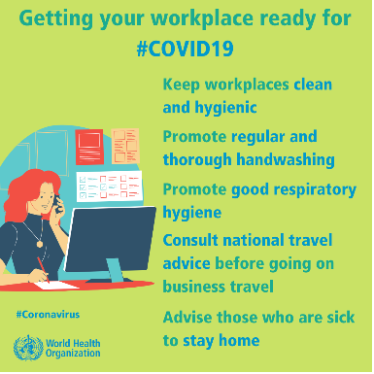

Slide 7
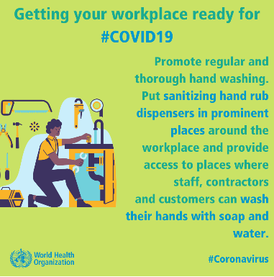

Slide 8
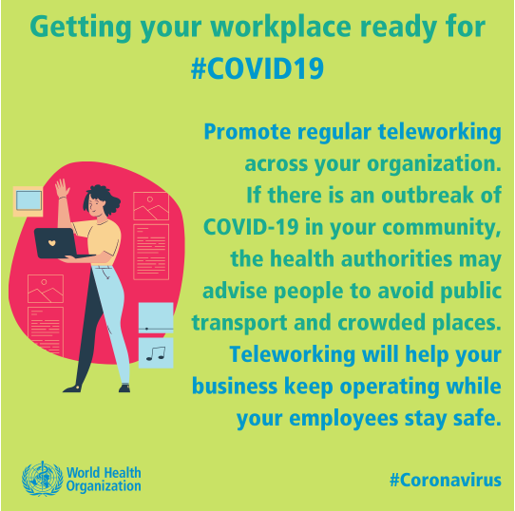

Slide 9

Covid-19 Guidance
Download workplace posters
Download personal hygiene materials
Links to www.ohiosystems.co.uk for information updates

